Slide 1

Project 1
Real Estate
Understanding the Influences upon Property Prices in Melbourne
Presented by:
Kali Notaras
Keerthi Chippa
Basudeb GhosH
Aayush Gupta
Christopher Banh

Slide 2


Project Description & Outline
Melbourne Property Price Insights
For Buyers:
For Sellers:
Key attributes influencing Property Prices
Insights per Living Demographic
Refined pricing estimates
Evaluate the performance of Melbourne’s top real estate agencies.

Slide 3
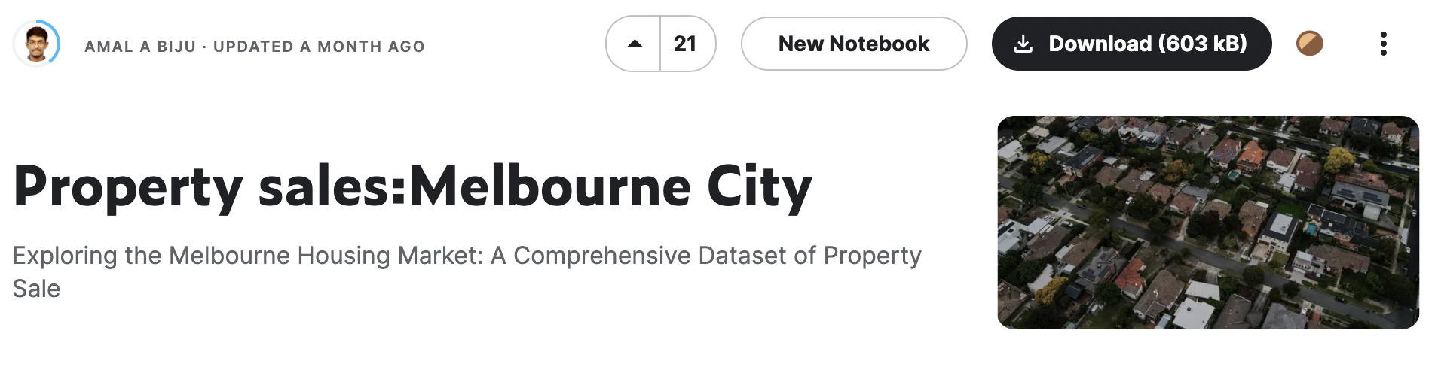
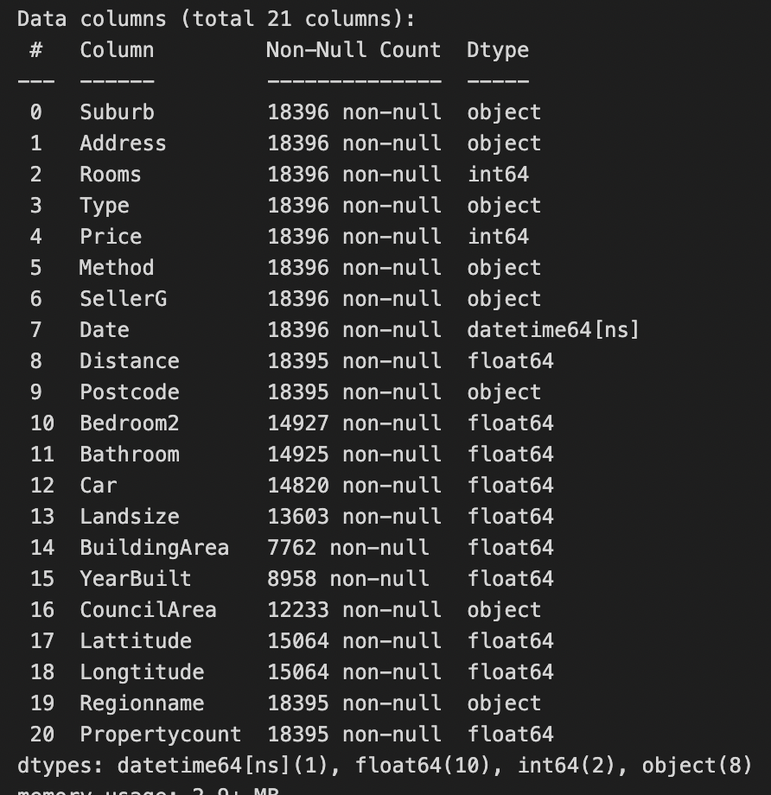
Dataset & Initial Data Cleaning
Source: Data generated by Biju, A.A. (2023). Property sales:Melbourne City.
Accessed on 4 April 2023. URL: https://www.kaggle.com/datasets/amalab182/property-salesmelbourne-city
Cleaned Dataset
21 Columns
18,396 Rows

Slide 4
QUESTION 1.
What are the main influences on Property Prices in Melbourne?

Slide 5
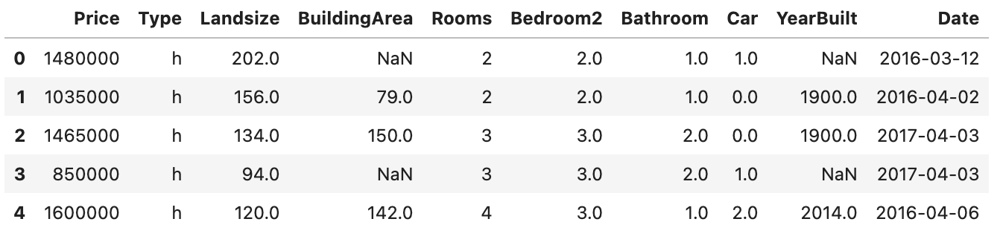
QUESTION 1.
Data Exploration & Cleaning
Dependent Variable
Price
Number of Bedrooms
Number of Bathrooms
Parking Spots
Year Built
Date of Sale
Independent Variables
Property Type
Land Size
Building Size
Rooms

Slide 6
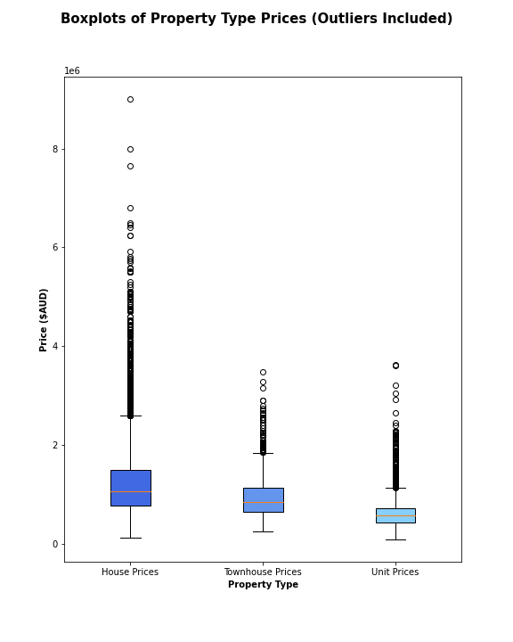
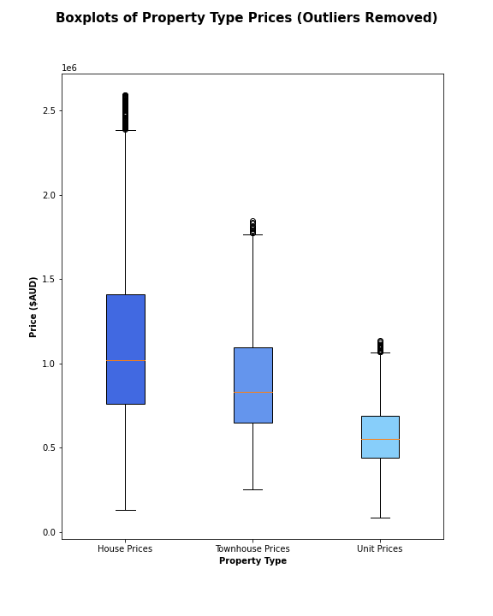
QUESTION 1.
Data Analysis: Property Type

Slide 7
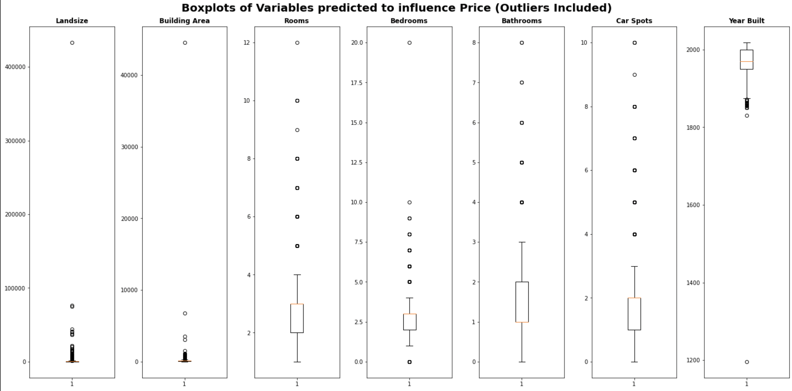
QUESTION 1.
Data Analysis: Dependent Nominal Variables

Slide 8
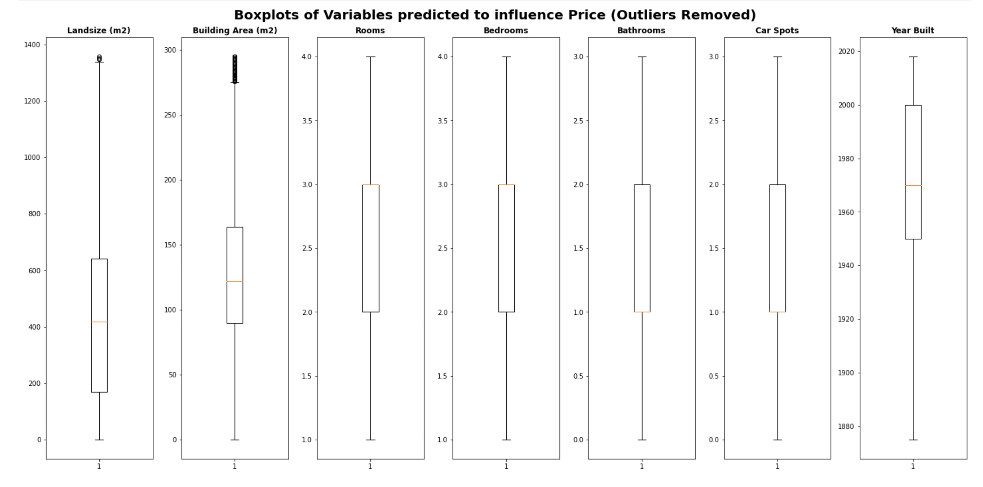
QUESTION 1.
Data Analysis: Dependent Nominal Variables

Slide 9
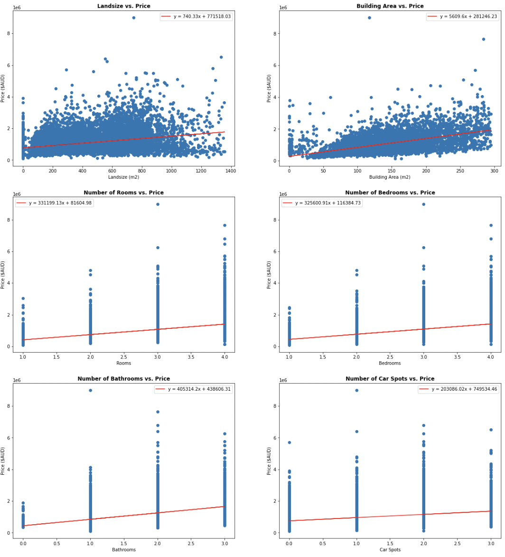
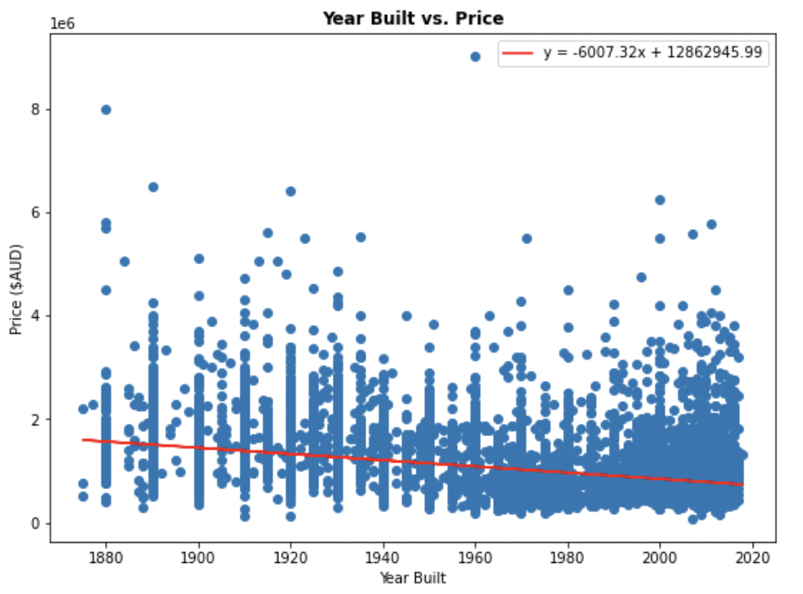
QUESTION 1.
Data Analysis: Dependent Nominal Variables
Continuous Variables
Ordinal Variables

Slide 10
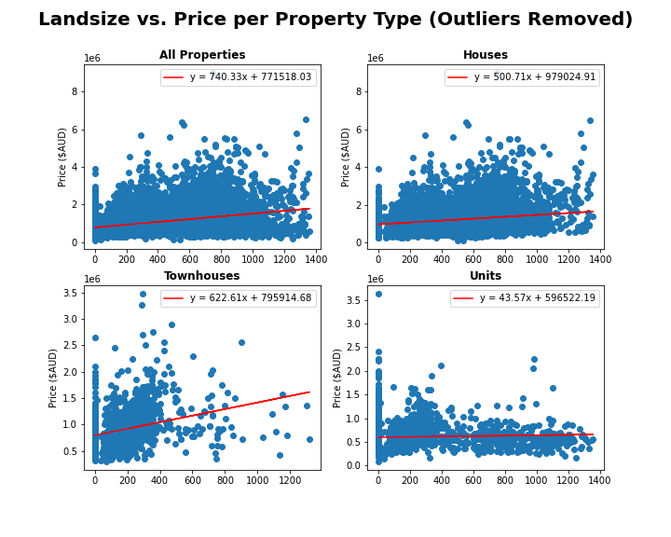
QUESTION 1.
Data Analysis: Dependent Nominal Variables
Correlation Values
All
House
Townhouse
Unit
0.339
0181
0.280
0.048

Slide 11
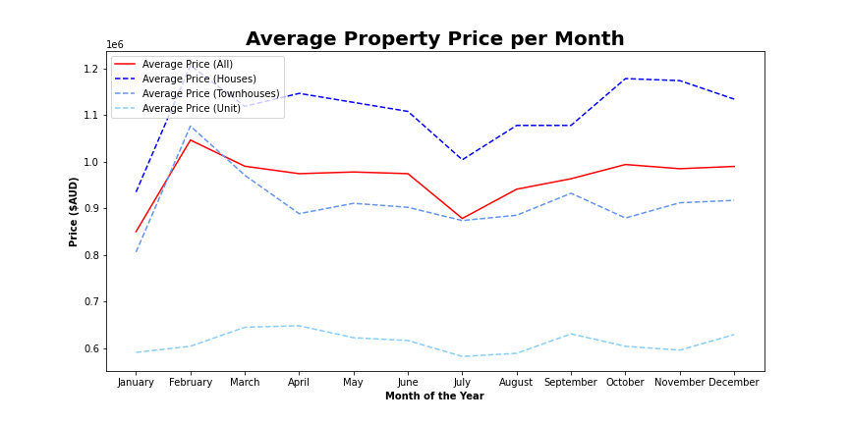
QUESTION 1.
Data Analysis: Date of Sale

Slide 12
QUESTION 2.
Looking to buy in Melbourne?
What location is best for your
living demographic & your budget?

Slide 13
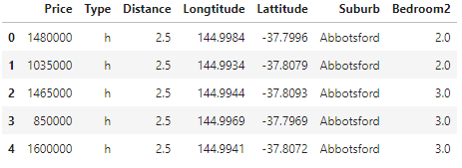
QUESTION 2.
Data Exploration & Cleaning
Dependent Variable
Price
Independent Variables
Distance from CBD
Longitude
Latitude
Suburb
Living Demographic
Property Type
Number of Bedrooms

Slide 14
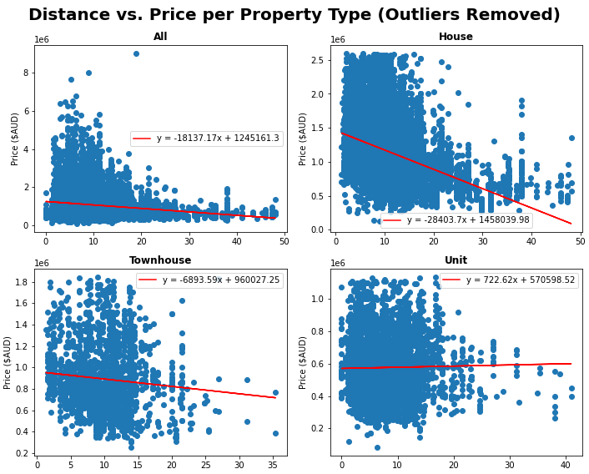
QUESTION 2.
Data Analysis: Linear Regression & Correlation
Correlation Values
All
House
Townhouse
Unit
-0.170
-0.380
-0.095
0.019

Slide 15
QUESTION 2.
Data Exploration: Living Demographics
Single
Couple
Property Type
Unit, Townhouse
Number of Bedrooms
<=2
Property Type
Unit, Townhouse, House
Number of Bedrooms
=2
Small Family
Large Family
Property Type
Unit, Townhouse, House
Number of Bedrooms
2-3
Property Type
House
Number of Bedrooms
>=3

Slide 16
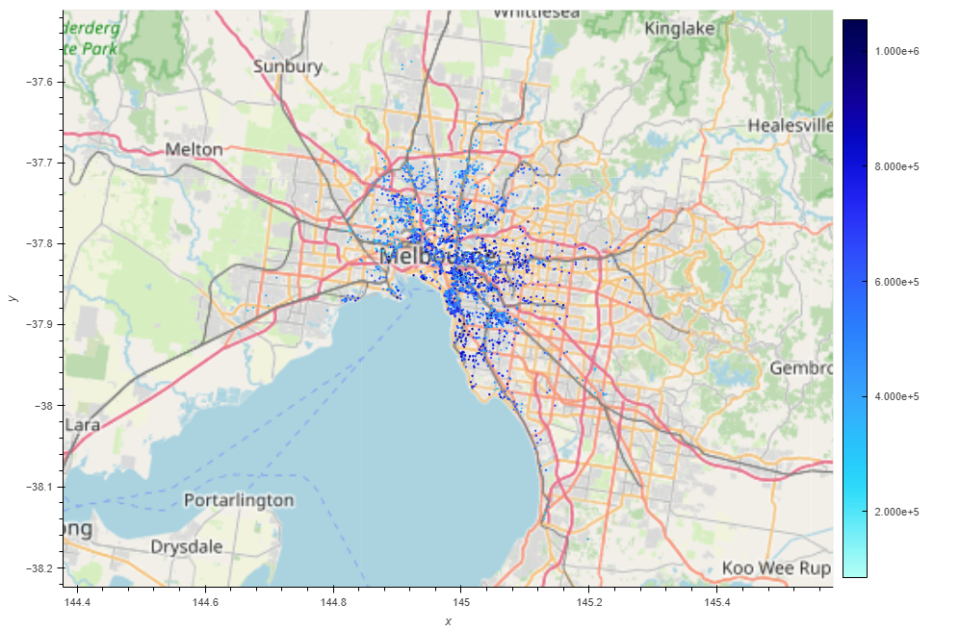
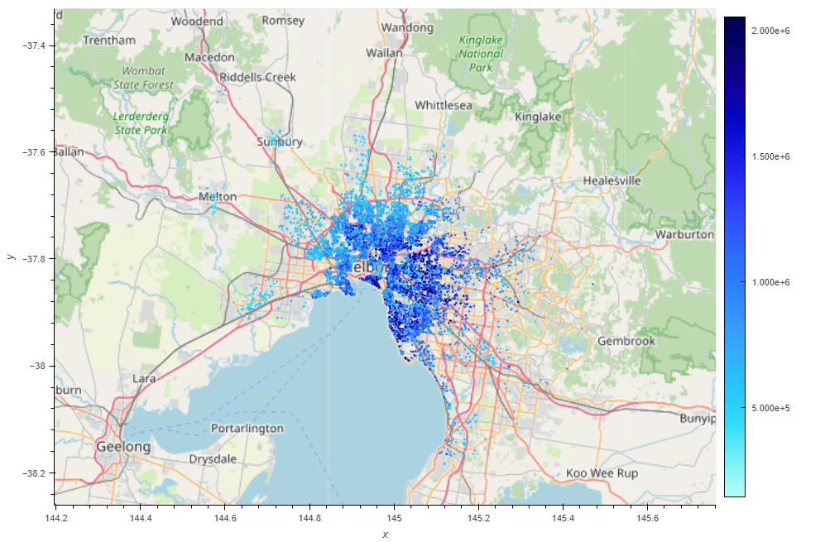
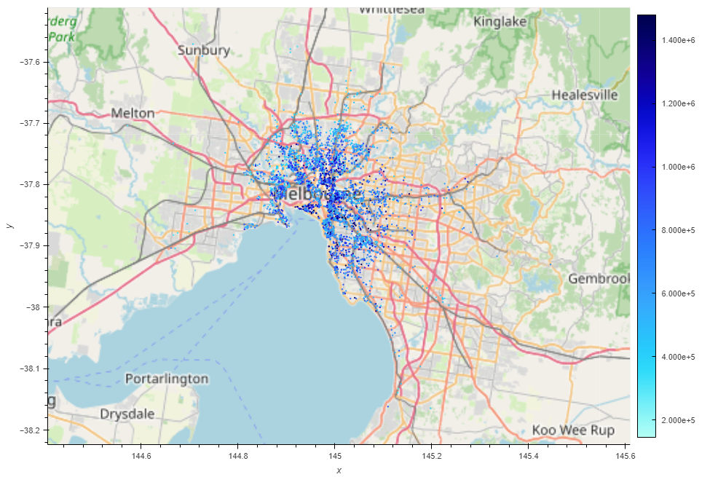

QUESTION 2.
Data Analysis: Property Maps

Slide 17
QUESTION 3.
Looking to sell in Melbourne?
Which real estate agency will get you the best value for your property?

Slide 18
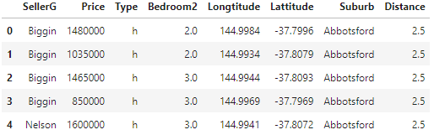
QUESTION 3.
Data Exploration & Cleaning
Dependent Variable
Price
Location
Longitude
Latitude
Suburb
Distance from CBD
Independent Variables
Seller
Living Demographic
Property Type
Number of Bedrooms

Slide 19
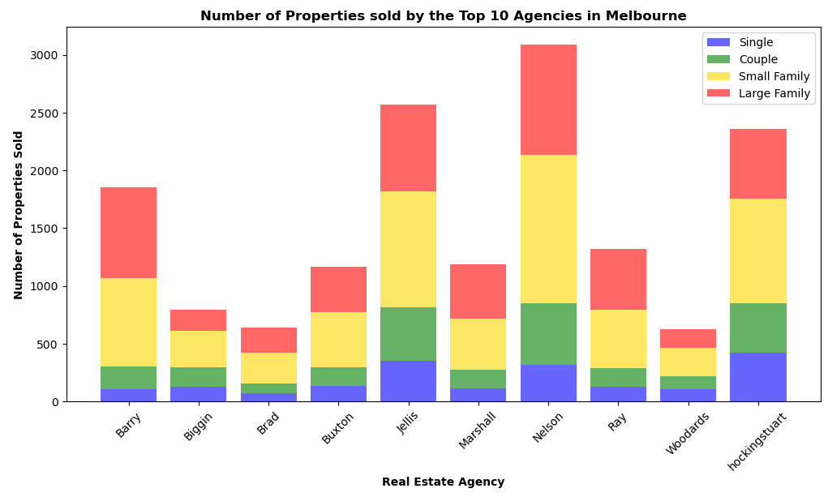
QUESTION 3.
Data Analysis: Top 10 Agencies

Slide 20
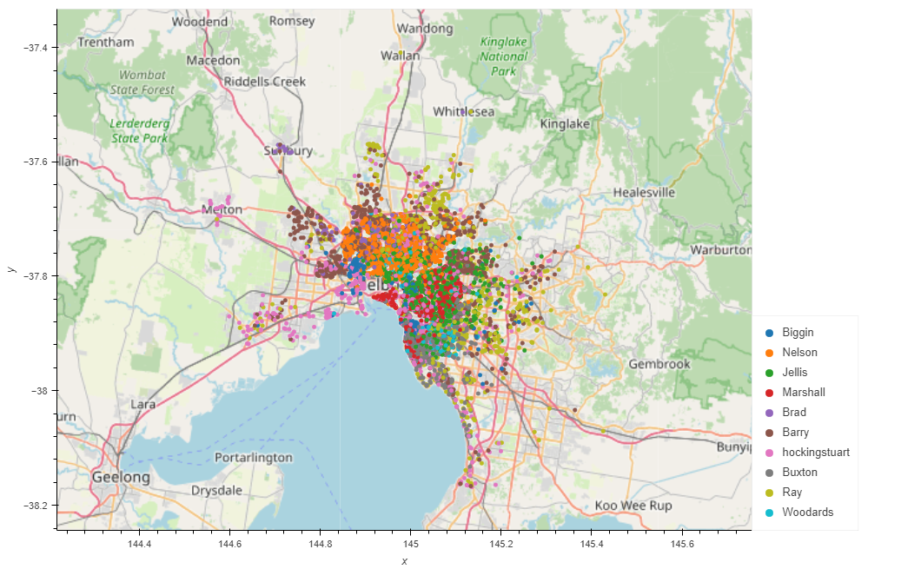
QUESTION 3.
Data Analysis: Map of Sales per Agent

Slide 21
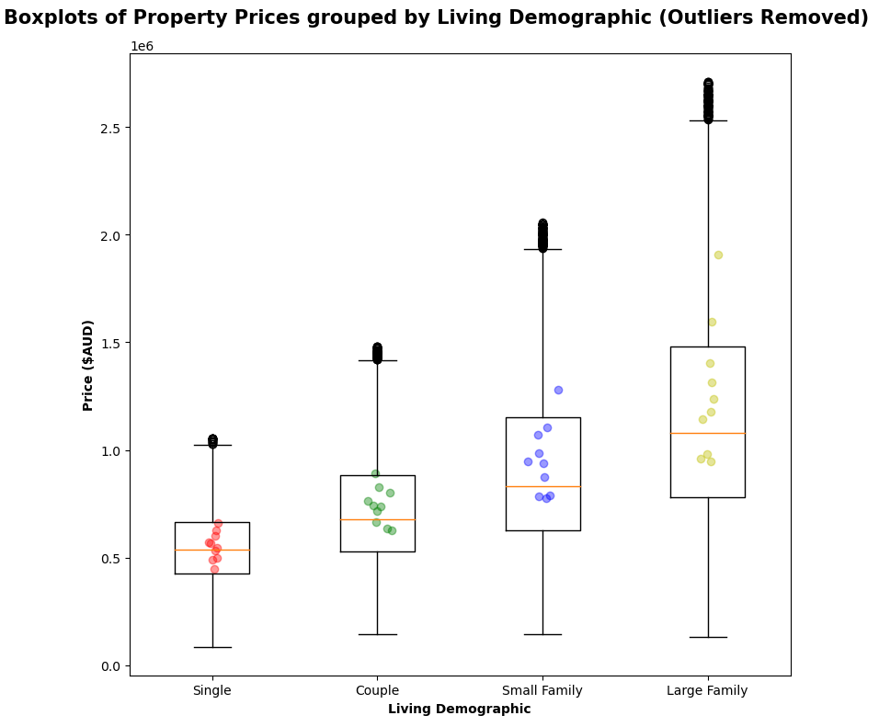
QUESTION 3.
Data Analysis: Performance above Average

Slide 22
SUMMARY
In-depth analysis of Property Prices for sellers & buyers in Melbourne

